Slide 1


FORTIFYING THE DIGITAL FRONTIER
Welcome to our presentation on enhancing cybersecurity awareness for IT professionals. In today's interconnected world, safeguarding digital assets is paramount. We'll explore how our solution empowers your team to identify and mitigate cyber threats effectively, ensuring a secure and productive work environment.

Slide 2


Agenda: Unlocking Your Cyber Resilience
01
02
03
The Cyber Landscape
Our Solution: A Proactive Approach
Core Components in Action
Understanding the evolving threat environment.
Diving into the code and functionality.
How our platform builds a culture of security.
04
05
Real-World Impact
Q&A and Next Steps
Benefits and success stories.
Your questions, our answers, and how to get started.

Slide 3

The Growing Threat: Why Cybersecurity Awareness Matters Now More Than Ever
Cyberattacks are increasing in sophistication and frequency, targeting organisations of all sizes. Human error remains a leading cause of security breaches, often exploited through phishing, social engineering, and weak credential management.
Phishing attempts increased by 61% last year.
95% of cyberattacks involve human error.
The average cost of a data breach is £3.3 million.

Slide 4





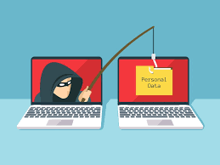
Introducing 'SecureWork': Our Proactive Defence Platform
SecureWork is designed to transform your IT professionals from potential vulnerabilities into your strongest defence line. We combine engaging training modules with real-world simulation to foster a security-first mindset.
Comprehensive Training
Realistic Phishing Simulations
Role-specific modules covering a range of cyber threats.
Test and improve your team's ability to detect threats.
Actionable Analytics
Empowering Culture
Track progress and identify areas for improvement.
Build a proactive and vigilant security culture.

Slide 5
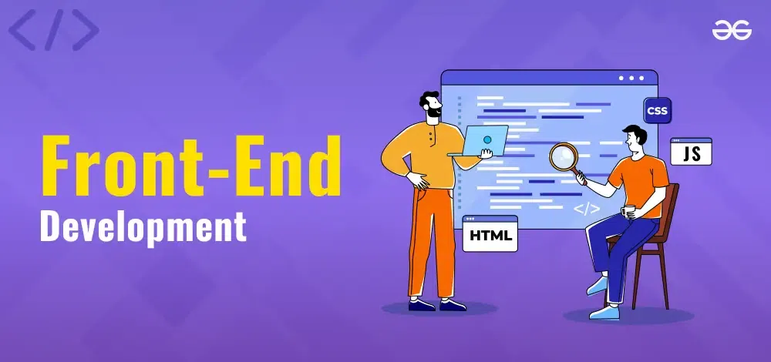
The Core: Frontend Architecture (Index.tsx)
const Index = () => { const [currentUser, setCurrentUserState] = useState(null); const [currentPage, setCurrentPage] = useState('home'); const [selectedModule, setSelectedModule] = useState(null); const [phishingToken, setPhishingToken] = useState(''); useEffect(() => { initializeData(); const user = getCurrentUser(); if (user) { setCurrentUserState(user); setCurrentPage('dashboard'); } }, []); // ... (handlers and renderCurrentPage function) return ( <> {showNavigation && (<Navigation user={currentUser} onLogout={handleLogout} onNavigate={setCurrentPage} />)} {renderCurrentPage()} </> );};
The Index.tsx component is the heart of our application's frontend. It manages the global state for user authentication, current page navigation, and selected training modules.
Dynamic Page Rendering: Utilises a currentPage state to conditionally render different views, providing a seamless user experience.
Modular Design: Integrates various components (LoginForm, Dashboard, ModuleViewer) to create a cohesive single-page application.
User Session Management: Employs useState and useEffect to manage the current user, persisting login status and directing users to their dashboard upon return.

Slide 6
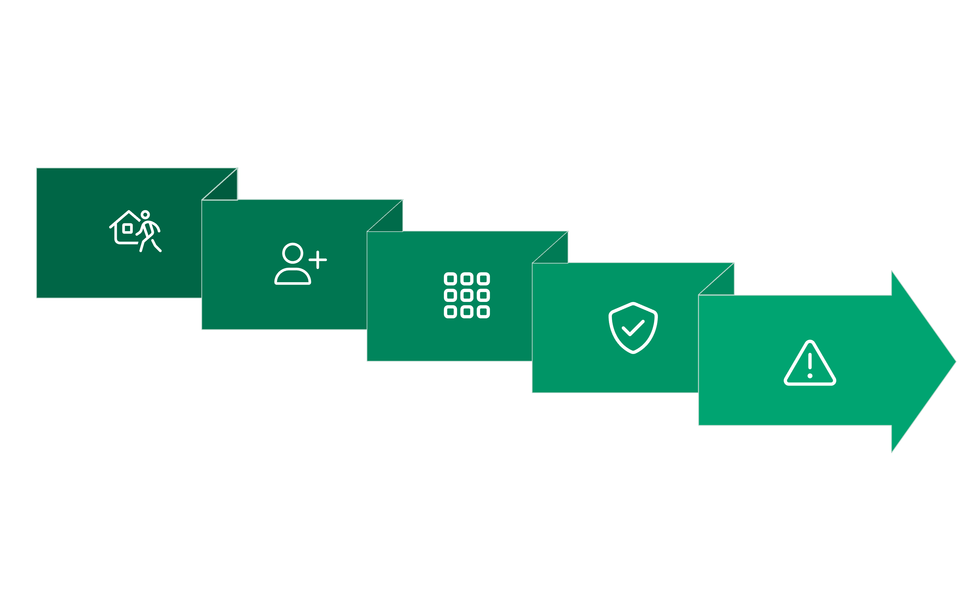






Navigating SecureWork: Page Flow & User Journeys
Our application supports a clear and intuitive flow, guiding users through registration, login, training, and administration.
Home → Register
Dashboard → Modules
Admin → Phishing
Register → Dashboard
Dashboard → Admin
The renderCurrentPage function acts as a central router, ensuring users are always presented with the correct interface based on their actions and authentication status.

Slide 7

Backend Foundations: Database Schema (Supabase)
Our Supabase backend provides a robust and scalable data infrastructure. Key tables manage user profiles, training content, and phishing simulation results.
profiles
user_id, username, is_admin, role
Stores user authentication details and role-based permissions.
modules
id, title, content, role
Houses all cybersecurity training content, categorised by user role.
progress
user_id, module_id, completed
Tracks individual user progress through training modules.
phishing_simulations
token, sent_to, clicked, reported
Records results and metrics from phishing simulation campaigns.

Slide 8
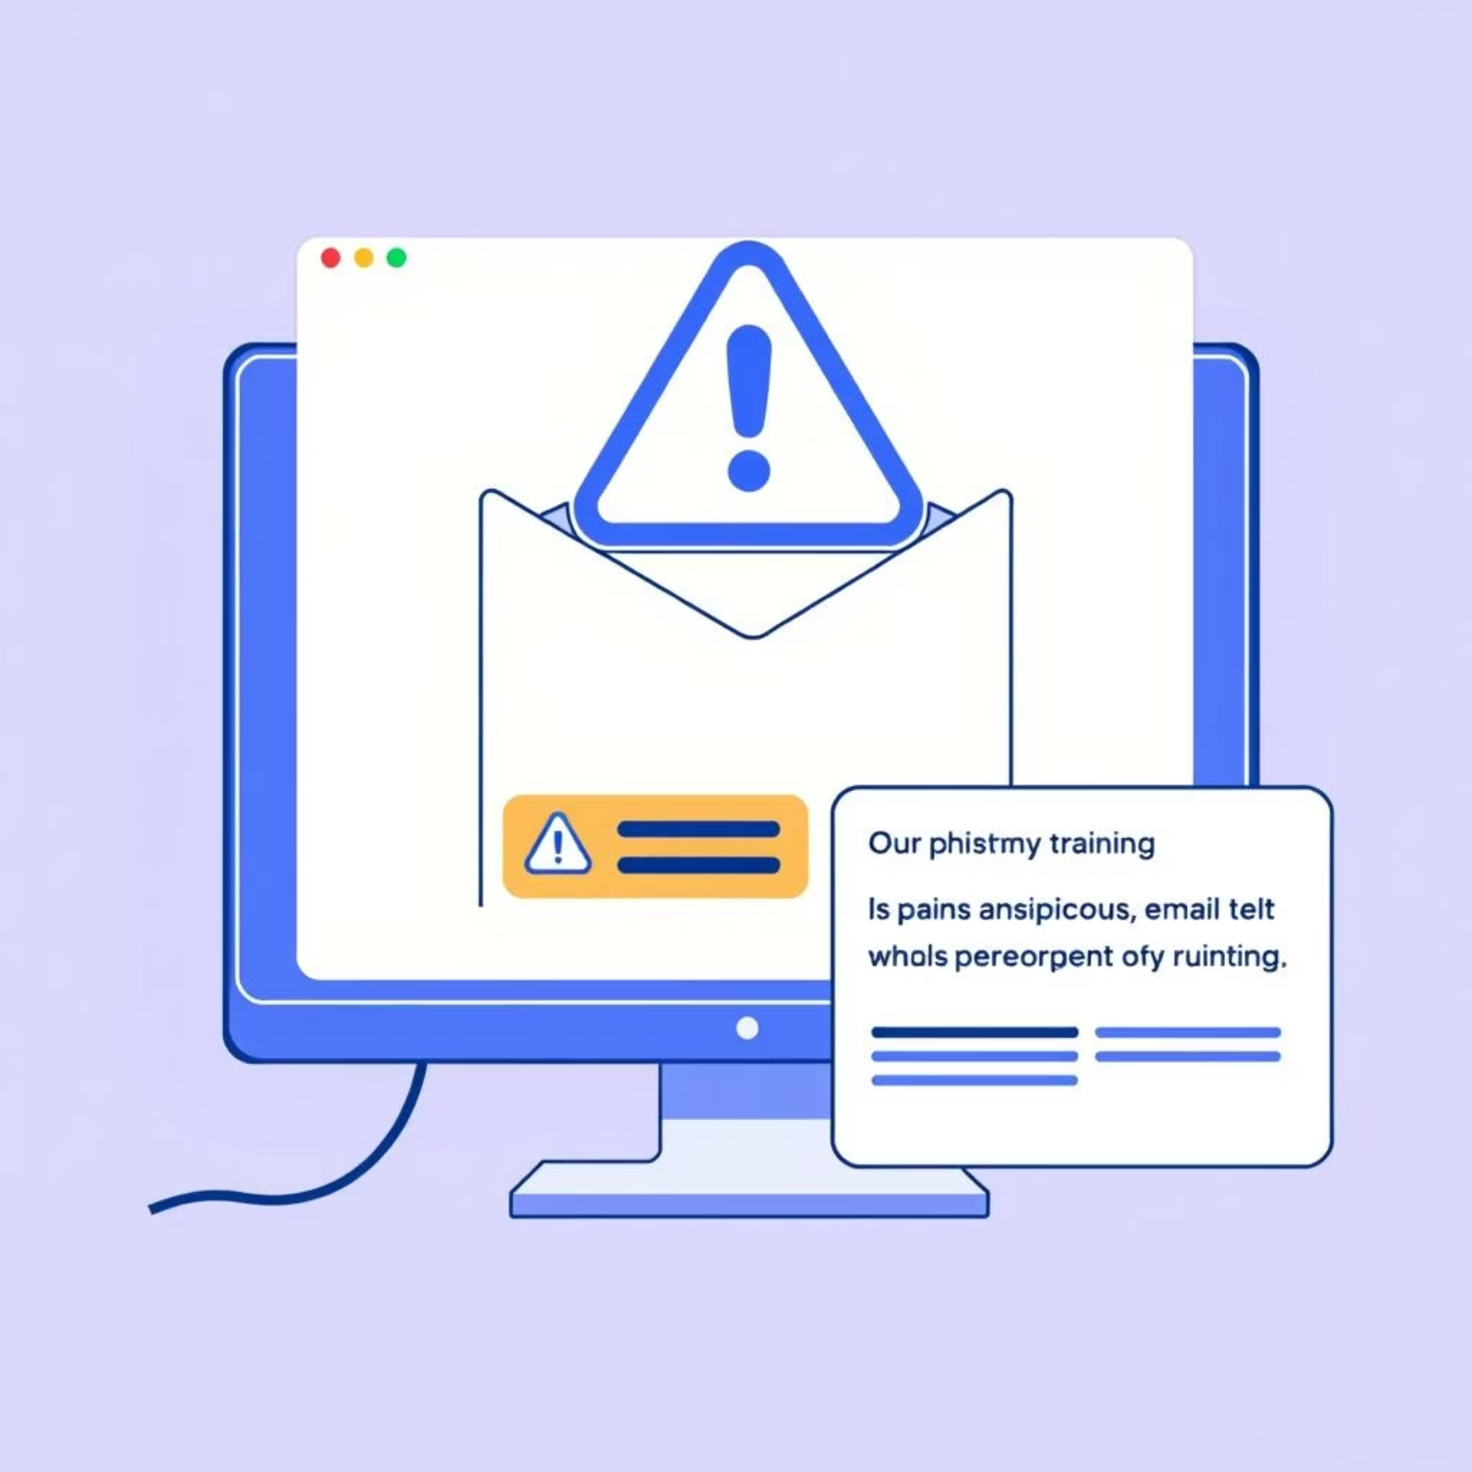
Phishing Simulation: A Practical Test of Vigilance
The PhishingLanding component and its related database entries are critical for our realistic simulation capabilities.
How It Works:
Admins initiate campaigns via AdminPanel.
Emails with unique phishingTokens are sent to users.
If a user clicks, they land on PhishingLanding, which
logs the interaction.
Users can report the phishing attempt, triggering an
update in the database.
Database Impact:
The phishing_simulations table records every interaction, providing crucial data on user susceptibility and reporting rates.

Slide 9


Key Takeaways: Building a Secure-First Workforce
Empower Your Team
Proactive Risk Reduction
Data-Driven Security
Our platform equips IT professionals with the knowledge and tools to identify and respond to cyber threats effectively.
By simulating real-world attacks, we foster vigilance and reduce your organisation's attack surface.
Analytics provide clear insights into your team's cyber readiness, allowing for targeted improvements.
SecureWork is more than just training; it's an investment in your organisation's long-term security posture.

Slide 10

Next Steps: Secure Your Organisation Today
Schedule a Demo: Experience SecureWork firsthand with a personalised walkthrough.
Pilot Programme: Implement a trial with a select team to see the immediate impact.
Customised Solutions: Discuss how SecureWork can be tailored to your specific organisational needs.

Slide 11


